Slide 1
Advancing Pennsylvania’s Cybersecurity
Michael Mattmiller
March 28, 2022

Slide 2
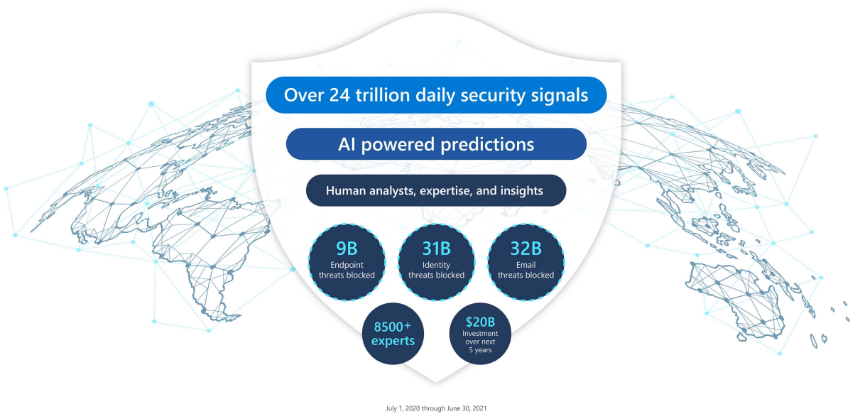
Microsoft security signals
Volume and diversity of signals processed by Microsoft
The Microsoft digital defense report draws on insights, data, and signals from across Microsoft, including the cloud, endpoints, and the intelligent edge.

Slide 3
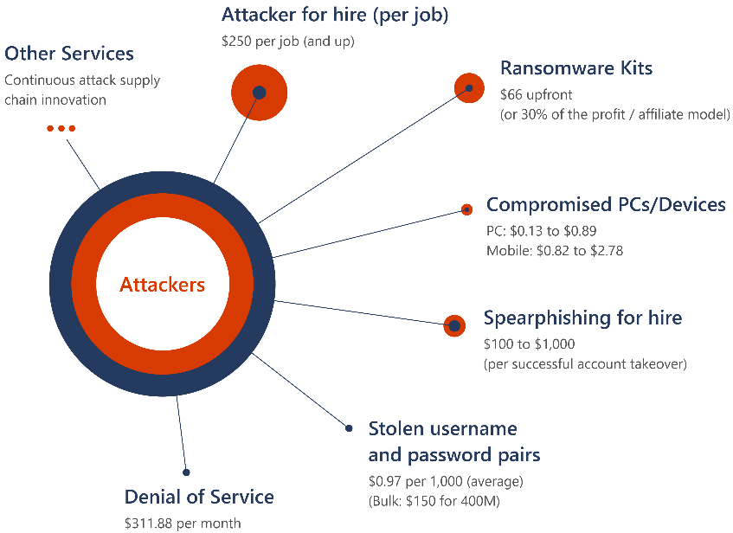
The state of cybercrime
With no technical knowledge of how to conduct a cybercrime attack, an amateur threat actor can purchase a range of services to conduct their attacks with one click.
POSITIVE TRENDS
Transparency: governments and companies coming forward
Priority: new laws, task forces, resources, partnerships
A threat to national security
Cybercriminals attacking all sectors
Ransomware attacks increasingly successful
Cybercrime supply chain continues to mature
The cybercrime economy and services

Slide 4
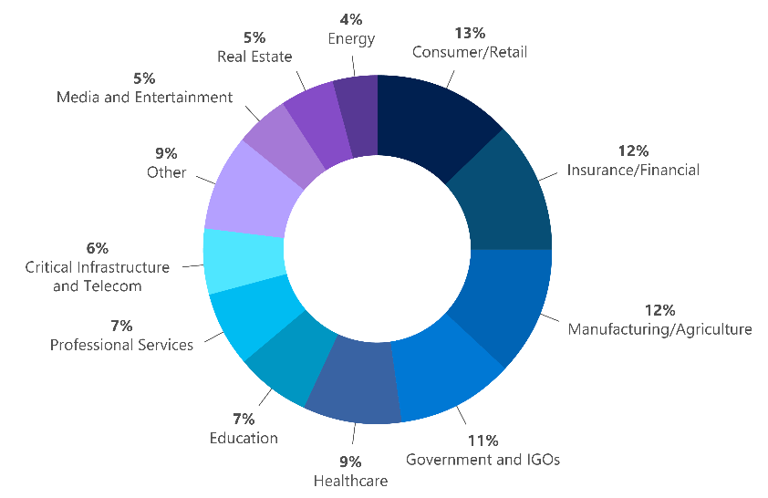
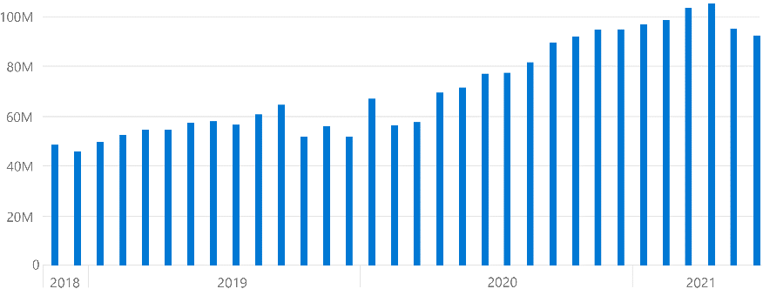
What we’re seeing in ransomware data and signals
Ransomware encounter rate (machine count): Enterprise customers (Defender data)
DART ransomware engagements by industry (July 2020-June 2021)
Overall increase in ransomware encounters, with notable surge to consumer and commercial encounters in late 2019,6 when RaaS started to grow, and in early 2020 at the onset of the COVID-19 pandemic.
Deploy ransomware protection
The stakes have changed. There is a massive growth trajectory for ransomware and extortion.

Slide 5
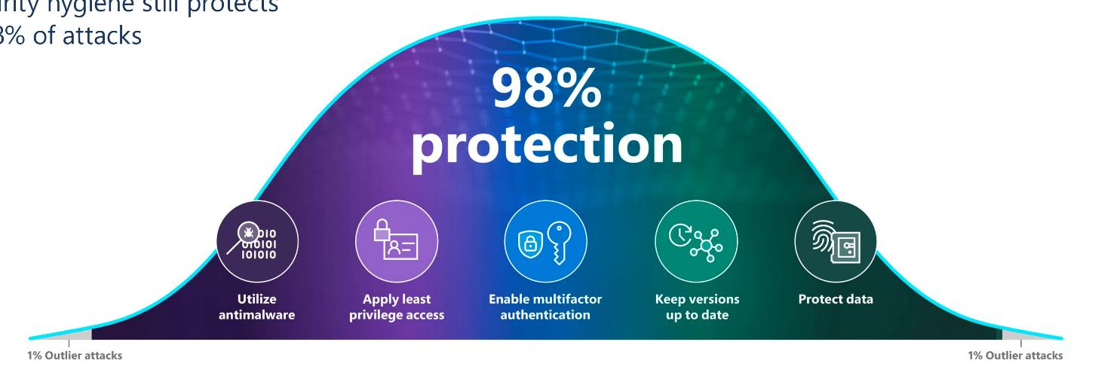
The cybersecurity bell curve:
Basic security hygiene still protects
Against 98% of attacks
Some key themes in the report:
Integrate cybersecurity into business decision making
Treat cyber as a business risk
Resilience includes cybersecurity
Zero Trust across the digital estate
Visibility
Automation
orchestration

Slide 6
Microsoft’s commitment to accelerate cybersecurity
MODERNIZE
SECURE
DEFEND
Benefits available to US State and select Local Governments
Modernize legacy software: productivity products including Windows, Exchange and SharePoint
One-year advanced protection package
Training for government IT and Security teams
Zero Trust guidance for configuration
Custom deployment services

Slide 7
Urgent action is needed to address the cybersecurity skills crisis
Cyberattacks threaten our privacy, national security, and our daily lives.
Only 3% of US students are attaining a credential in computer and information sciences, far fewer specialize in cybersecurity.
With nearly 500,000 open cybersecurity roles in the US, skills in cybersecurity can help launch students into high-growth, high-paying jobs.

Slide 8
Our commitment
Help skill 250,000 people in cybersecurity by 2025—starting with new community college and nonprofit partnerships—to cut the US talent gap by 50%

Slide 9
Supporting your institution with cybersecurity resources
Faculty professional development support​
Community of practice to support expanding cybersecurity programs
Scholarships for low-income students including Veterans
Ready-to-teach curriculum and teaching materials

Slide 10
Thank you
View the Digital Defense Report report https://aka.ms/MDDR
Learn more about Microsoft’s Cybersecurity Community College commitment: Microsoft on the Issues
Learn more about Microsoft in Government https://www.microsoft.com/government

