Slide 1

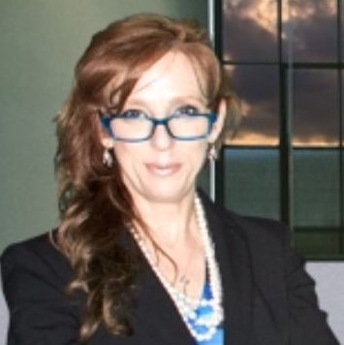
HP and Cyber security leadership
Cyber security risks
and what the great State of Pennsylvania can do to help reduce the cyber security risks
Michael Howard
Chief Security Advisor and
Head of WW Security & Analytics Practice
Dr. Kimberlee Ann Brannock
Senior Security Advisor

Slide 2
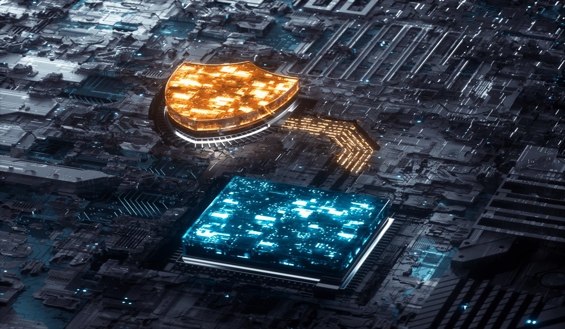
Agenda:
Contributing factors increasing Cyber Security risk today
HP predictions of future Cyber Security risk
End Point device security explained
Industry recognized approach – NIST Cyber Security Framework and associated controls
Notes:
Organizations are currently continuing to go through the COVID-19 pandemic with other global events unfolding while preparing for any future event that is likely to disrupt the business.
Because of these types of events, organizations have an obligation as responsible corporate citizens to ensure that everyone is safe.
Organizational leaders have an obligation to enable their employees to work safely, comfortably, and remotely with the highest level of security possible.
This includes ensuring the work that is conducted is being done in a manner to protect the individual, the organization, and the associated company data.
When this is not a key consideration, organizations introduce significant risks where it is foreseeable harm occurs at the individual and organizational level.
To help enable this to be a key consideration, Michael and Kimberlee will share outcome-based security leadership to help protect you, your people, brands, and your reputation.
Michael and Kimberlee are providing an overview of a cybersecurity model/framework comprised of cybersecurity best practices for your consideration for adopting into your remote contingency plan.
By implementing the cybersecurity model/framework, organizations will reduce the impact of loss of life, protect brand and reputation, alleviate and deter cybersecurity risk and vulnerabilities, avoid legalities and fines, and improve your overall security posture.

Slide 3






The pandemic introduced additional pressures to existing cyber threats
Global pandemic saw organizations pivot from an office-based workforce model to hybrid work increasing cyber risk.
This is not a short-term trend
23% of office workers globally expect to work from home from now on, with 16% expecting to split their time equally between work and home.
47% of surveyed office workers working from home see security as a hindrance.
Cybersecurity teams facing an uphill battle trying to secure the perimeter-less workplace – burnout is a significant risk
83% think WFH is a “ticking time bomb for network breaks; IT teams see an iceberg looming ahead in the form of a data breach and feel unheard
91% of cyber security teams under pressure to compromise security best practices to enable business continuity through WFH resulting in greater cyber risk
In 2020, endpoints connected to the internet experienced 1.5 attacks per minute (KuppingerCole).
WFH has driven an increase in cybercrime with reduced visibility for security and an increasingly distributed workforce outside of the range of IT.
31% of office workers surveyed aged 18-24yr have tried to circumvent security
Source: HP Wolf Security Report 1 ‘Blurred Lines and Blind spots’ and 2 ‘Rebellions and Rejections Report’

Slide 4









Cyber security
Trends for remainder of 2022
Supply Chain Cyber Security Events will continue, and likely increase
Remote work and hybrid work will continue, where every single one of us is a target for cyber security events
Big data and associated tools, including IA, machine learning and algorithms will thrive and bring with it significant cyber security risk and threats
Cloud cyber security risks will continue to increase
Dis-information campaigns and misinformation will continue to flourish
Social engineering attacks will continue to work (examples: phishing campaigns & sophisticated, deep fake technology (includes being weaponized due to synthetic media (AI-generated faces, voices, etc.) )
5G and Broadband not adequate in U.S. and as roll outs continue, cyber security risk will follow
Cyber crime will continue to flourish (organized, agile, well funded (employer for hackers) (Ransomware via sophisticated penetration tools ; fileless attacks)
Endpoint devices, IoT devices, mobile devices will be targeted for attacks
Notes:
NOTES:
Remote work and hybrid work models will continue for the foreseeable future and the work landscape has forever changed. The disparity between the remote office and the tradition “office” presents a wide spectrum of new cyber security risks, vulnerabilities that are exploitable and will be exploited if not addressed proactively. Cyber security professionals need to prepare for the ever-changing threat landscape, which includes emerging cyber security threats.
Social Engineering Attacks: Phishing & Deepfake technology weaponized
Techniques for fake data, video and audio are advanced enough to be weaponized and used to create targeted content to manipulate opinions, stock prices and even worse. As in the case of other mobile attacks that rely on social engineering, the results of a phishing attacks can range from fraud to more advanced espionage. Example: Deepfake phishing attack where a bank manager in the United Arab Emirates fell victim to a threat actor’s scam. Hackers used AI voice cloning to trick the bank manager into transferring $35 million. Threat actors will use deepfake social engineering attacks to gain permissions and to access sensitive data.
Cybercrime via ransomware will continue to grow despite the efforts of law enforcement (FBI, Interpol and Europol, etc.). Threat actors will target companies that can afford paying ransom (even though they should never pay), and ransomware attacks will become even more sophisticated in 2022. More fileless attacks will continue to emerge; very hard to track and trace as there is no file needed to execute the attack…runs in memory instead to serve as an example.
Hackers/Crackers will increasingly use penetration tools to customize attacks in real time and to live and work within victim networks as we have observed in several recent cyber security events, and this is already very evident with APTs (Advanced Persistent Threats: Russia, China, Iran as examples). Penetration tools are the engine behind some of the most sophisticated ransomware attacks that took place in 2021 and are continuing in 2022. It is foreseeable and likely the respective attackers will carry out data exfiltration and extortion attacks as part of their respective attacks.

Slide 5


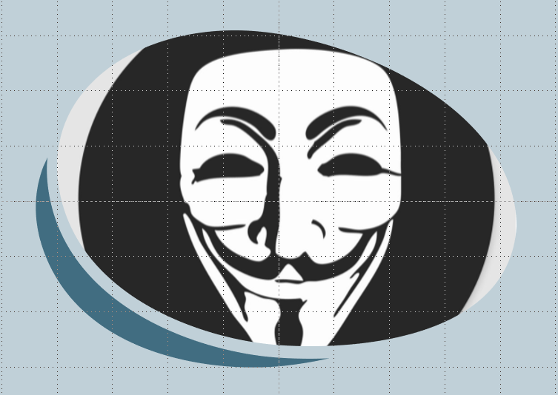
Recent example of endpoint devices targeted for attacks
End Point devices targeted: Print Devices
Printer attack on Russian print devices
Exploited print devices in Russia printing anti-propaganda and Tor installation instructions to print devices all over #Russia and printed 100,000+ copies in two hours
Tor is opensource internet browser that could allow Anon to communicate with ppl for future updates
The details of the latest attack against Russia were shared by Anonymous on Twitter
Notes:
We are sharing this simply to serve as a current example of end point devices targeted, which just so happened to be a successful end point device attack by Anonymous, who is a decentralized international activist and hacktivist collective and movement primarily known for its various cyber attacks against several governments, government institutions and government agencies, corporations, and churches.

Slide 6





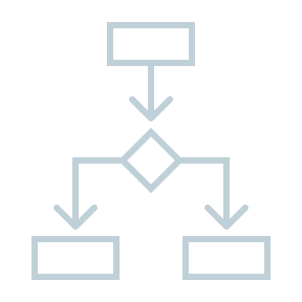

HP Predictions
More privacy & cyber security legislation at national and local levels
Due to types of cyber security events, policy complexities follow, including nation states passing legislation to regulate ransomware payments, fines & negotiations, etc.
Crypto-currency risks will increase
Cyber security will continue to NOT to be inherent in anything we do
Threat actors weaponized operational technology environments successfully enough to cause human casualties
Cyber-warfare amongst nations will increase
More boards of directors will have a dedicated cybersecurity committee overseen by a qualified board member in next ten (10) years
Cyber security will be used as a decision-making factor & measure to procure, hire third parties, and conduct business by more than 50% of existing organizations in the next five (5) years
2022 will prove to be the most challenging year yet with regards to the ongoing cybersecurity talent gap (continued supply and demand will cause salary spikes across the board for every level of cyber security professional).
Notes:
General Data Protection Regulation (GDPR) in the EU
California Consumer Privacy Act (CCPA)
Latin American Data Protection Regulation (LADPA) (Argentina, Chile, Colombia, Costa Rica, Mexico, Nicaragua, Paraguay, Peru, Uruguay)
Gartner: By the end of 2023, modern privacy laws will cover the personal information of 75% of the world’s population.

Slide 7
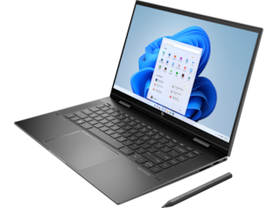
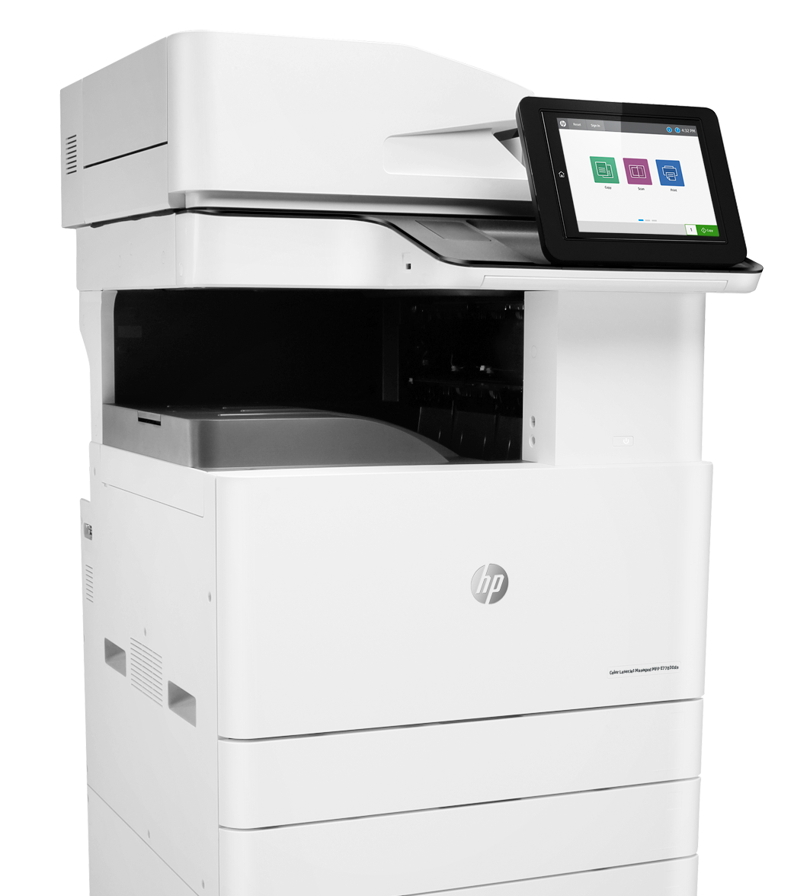
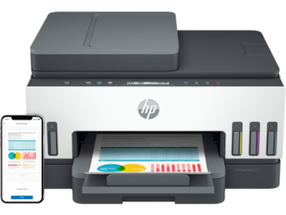
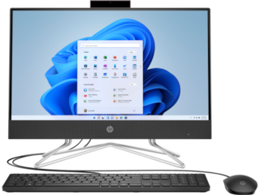
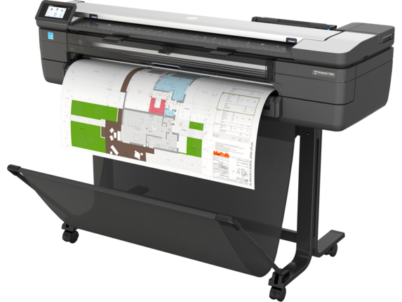
What are end point devices and why are they vulnerable
Endpoint devices” means any addressable, programmable, intelligent device that is connected to the network; and includes and is not limited to personal computing goods, including desktops, laptops, all-in-one devices, tablets, thin clients, monitors in any size, and print devices.
Endpoint devices also includes multifunctional devices, including imaging devices, which combines a combination of operations, such as copying, printing, scanning, and faxing, into a single machine.
Vulnerable because
  Overlooked due to the nature of its job
  Not configured or not configured correctly
  Not managed
  Not maintained, which includes patching
  Unmanaged
  Legacy devices

Slide 8
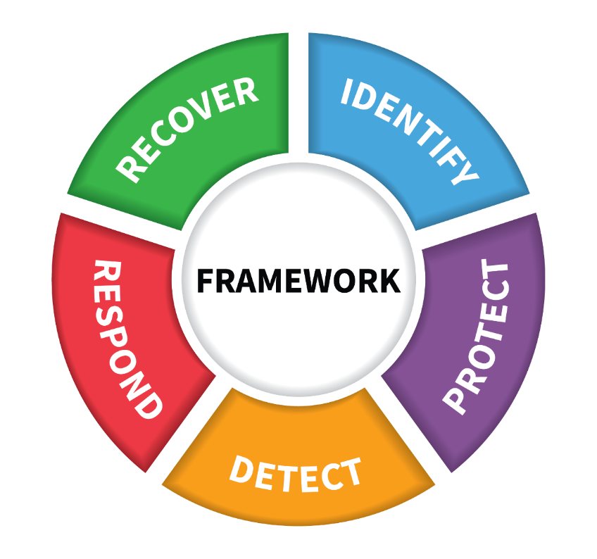
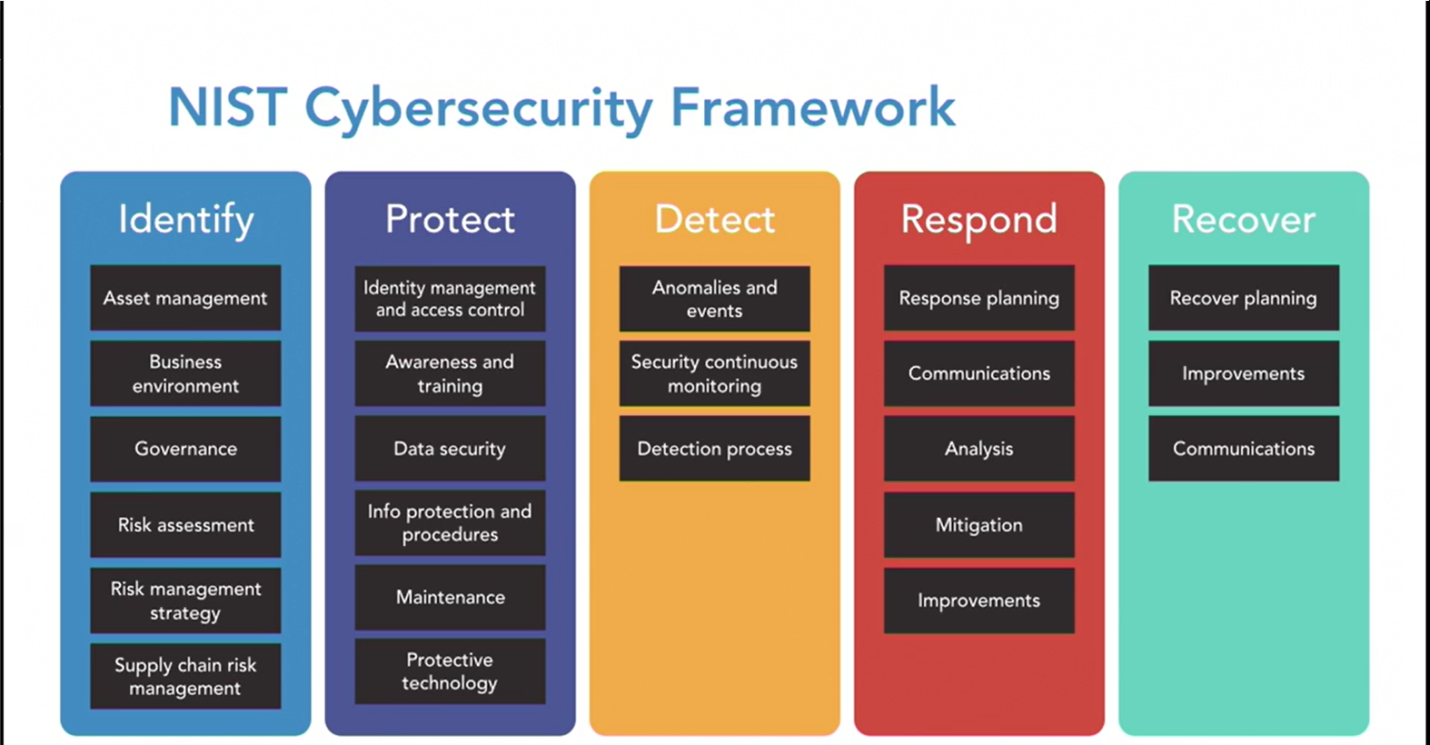
Existing NIST Cyber Security Framework & associated controls improve overall security posture and cyber resilience
Notes:
1.) When procuring end point devices, we should require those devices, services and solutions to meet the National Institute of Standards and Technology (NIST) guidelines and best practices for computer security; and the U.S. Department of Defense Supply Chain Risk Management (SCRM) guidelines, which includes the NIST Cybersecurity Framework.
2.) With this in mind, it is advisable to update end point device procurement requirements as a result.
3.) Michael and Kimberlee are providing an overview of a cybersecurity model/framework comprised of cybersecurity best practices for your consideration for adopting into your cyber security plan.
4.) By implementing the cybersecurity model/framework, organizations will reduce the impact of loss of life, protect brand and reputation, alleviate and deter cybersecurity risk and vulnerabilities, avoid legalities and fines, and improve your overall security posture.

Slide 9
High level - Language requirements needed in statutes and directives
Specific recommendation for endpoint security in conjunction with the NIST Cyber Security Framework and maturity model, also include technical requirements, including and not limited to
  SP 800-53 - including requirements for endpoint Software and Firmware within it
    Security and Privacy Controls for Information Systems and Organizations
    relevant for showing that NIST recommends having both SW and FW controls
  SP 800-193 for endpoint hardware design for firmware resilience requirements
    Platform Firmware Resiliency Guidelines
    relevant to Print and PC security leadership and leadership in resiliency
  SP 800-147 – for Firmware update security requirements for PCs and computers
    BIOS Protection Guidelines
    relevant to all tier-1 OEM HP PC and Print security
    industry best practice
  SP 800-204 – for security strategies for micro-services applications
    Security Strategies for Microservices-based Application Systems
    relevant to technologies such as Sure Click and Sure Access; demonstrating cyber security innovation
  SP 800-207 – for Zero-Trust architectures
    Zero Trust Architecture
    relevant to HP Sure Click, Sure Access, and a number of HP PC and Print security technologies
Notes:
Additional documents to reference:
NISTIR 8276 (National Institute of Standards and Technology Interagency Report).: Key Practices in Cyber Supply Chain Risk Management: Observations from Industry: https://csrc.nist.gov/publications/detail/nistir/8276/final
SP 800-161: Supply Chain Risk Management Practices for Federal Information Systems and Organizations; guidance to manage cyber security risk in supply chains. Can be tailored and customized to meet individual needs

Slide 10
High level - Language requirements needed in statutes and directives continued…
Consider adding other dimensions for HW
  Certification
  Strong interest in services provider and supplier certification
    FedRamp for cloud and service delivery right now, could expand to products and endpoints later
      CMMC for supply chain
  PC certifications:
      TPM hardware certification is common across first tier OEM
      EC hardware certification is unique to HP – but only uses French Government national lightweight certification scheme (soon to align with German/EU scheme
  Print certifications (to be confirmed)
      Two well established Common Criteria certifications for Hardcopy devices
      One unique Common Criteria certification for intrusion detection
      Keypoint intelligence print security validation (3 seals)
      Supply Chain security certification for LaserJet (two OEMs currently do this)
IoT security, with examples to consider:
    California bill (may not be what we want to recommend)
    ETSI EN standard (HP involvement in helping lead in IoT security standard with Print)
    UK legislation

Slide 11

EVERY ENDPOINT
DECISION
IS A
SECURITY
DECISION
When procuring end-point-devices, we should prioritize security
as one of the key foundational requirements for end-point devices, service and
solution acquisitions and objectively weigh security in all procurement evaluations
Notes:
In this environment, it’s critical to understand that every end point purchase decision an organization makes will either make them more vulnerable or less vulnerable to attacks. Security is no longer just the responsibility of the ITDM. Today, every decision you make is a security decision, which is why it is an integral part of every conversation we have, and why HP is considering security in everything we design and innovate.

Slide 12
Thank you
Notes:
Thank you

